Slide 1
WiFi Sniffer w/RaspberryPi
yintao_ling

Slide 2
RaspberryPi Connection
Console：
SSH
File：
FTP
GUI：
VNC Server (Not supported Wireshark)
RDP Server

Slide 3
RaspberryPi Connection
172.16.0.49
ssh://172.16.0.49
ftp://172.16.0.49
vnc://172.16.0.49:5901
rdp://172.16.0.49 (One user only for free license. Wireshark Available.)

Slide 4
RaspberryPi Setup
yintao_ling

Slide 5
RaspberryPi Setup - VNC Server
Tightvncserver
Modified ~/.vnc/xstartup for Kali & Windows 10
Auto start script in /etc/init.d/vncserver (rc.d)
Auto start script in /etc/systemd/system/vncserver@.service
Auto start by crontab
@reboot su - kali -c ‘/usr/bin/vncserver :1 -geometry 1024x768’

Slide 6
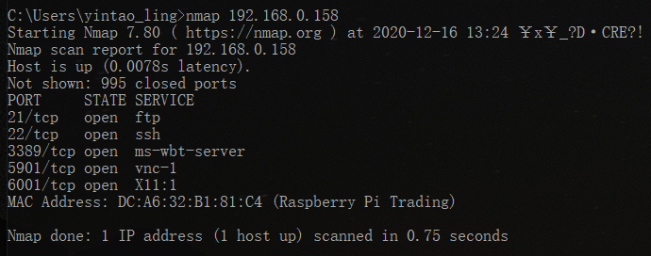
RaspberryPi Setup
Port 5901 - VNC Server
Port 3389 - RDP Server

Slide 7
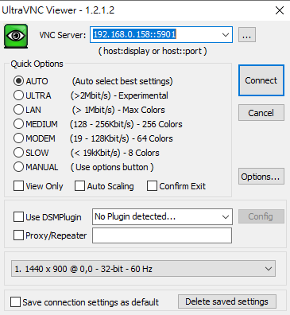
RaspberryPi Setup - VNC Server
Using UltraVNC on Windows.
Address = <IP>::5901

Slide 8
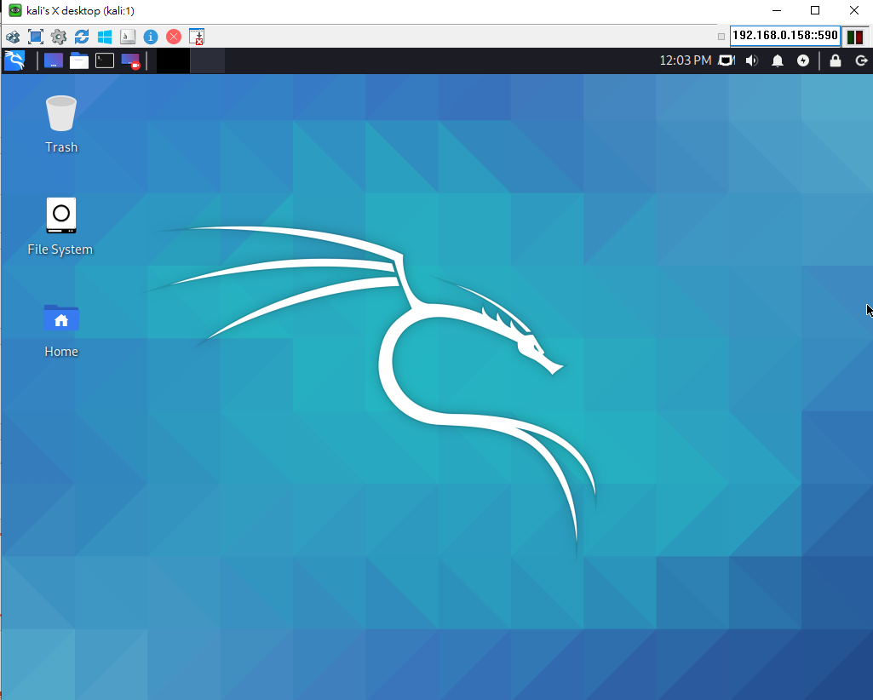
RaspberryPi Setup - VNC Server

Slide 9

RaspberryPi Setup - RDP Server
Windows Remote Desktop

Slide 10
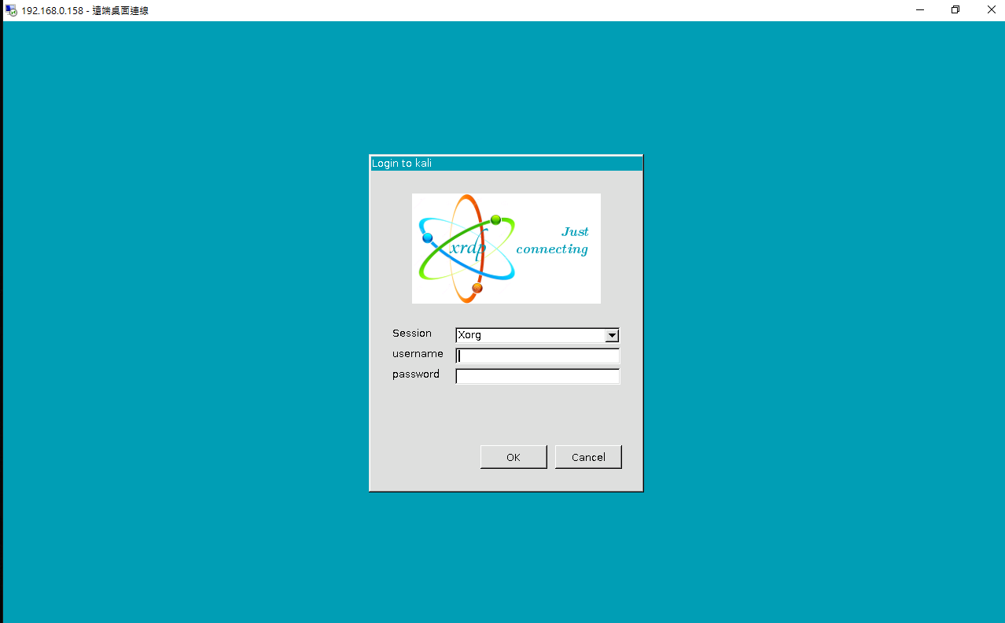
RaspberryPi Setup - RDP Server

Slide 11
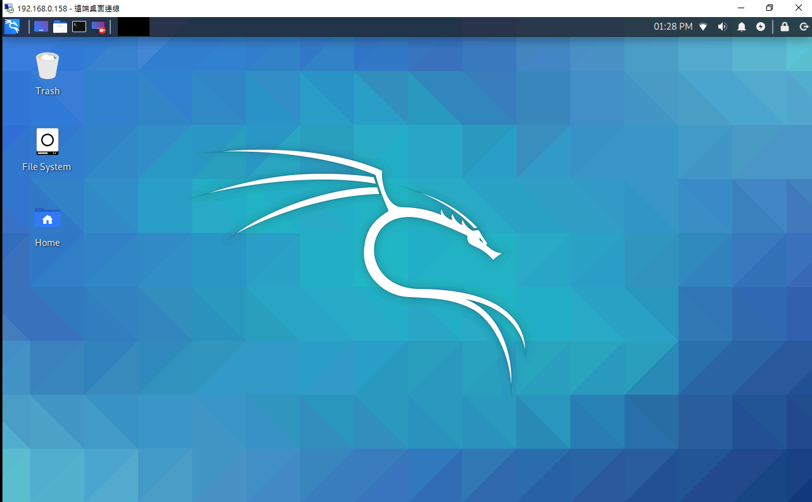
RaspberryPi Setup - RDP Server

Slide 12
Wireless Commands
yintao_ling

Slide 13
Wireless commands
ifconfig wlan0 up/down
iwconfig wlan0 essid <NAME> key s:<PASSWORD> (WEP)
/etc/wpa_supplicant.conf (WPA)
dhclient wlan0
nmcli
sudo iwlist wlan0 scan | grep ssid | sort

Slide 14
802.11 on Wireshark
yintao_ling

Slide 15
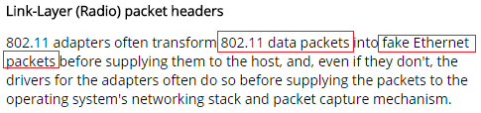
Wireshark
In normal situations user cannot see 802.11 Frame from Wireshark.
Link-Layer transforms 802.11 packets into fake Ethernet packets.
Reference from Wireshark Website.

Slide 16
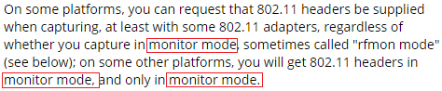
Wireshark
In order to see 802.11 Frame, Wi-Fi adapter and OS must be in monitor mode.

Slide 17
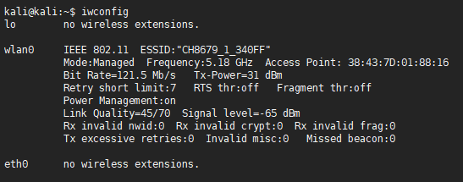
Managed Mode
Wireless Interface Info.

Slide 18
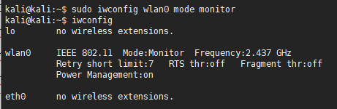
Monitor Mode
Wireless Interface Info.

Slide 19
Monitor Mode
There are 3 tools to change Wireless interface into monitor mode.
iw
iwconfig
airmon-ng
Remember to disconnect current ESSID.

Slide 20
iw
Managed Mode to Monitor Mode
sudo ip link set wlan0 down
sudo iw wlan0 set monitor mode
sudo ip link set wlan0 up
Monitor Mode to Managed Mode
sudo ip link set wlan0 down
sudo iw wlan0 set type managed
sudo ip link set wlan0 up

Slide 21
iwconfig
Managed Mode to Monitor Mode
sudo ifconfig wlan0 down
sudo iwconfig wlan0 mode monitor
sudo ifconfig wlan0 up
Monitor Mode to Managed Mode
sudo ifconfig wlan0 down
sudo iwconfig wlan0 mode managed
sudo ifconfig wlan0 up

Slide 22
airmon-ng
Check supported interface = sudo airmon-ng
Check related processes = sudo airmon-ng check kill
Close related processes = sudo airmon-ng check kill
sudo airmon-ng start wlan0
sudo airmon-ng stop wlan0mon

Slide 23
Approach 1 - airmon-ng
yintao_ling

Slide 24
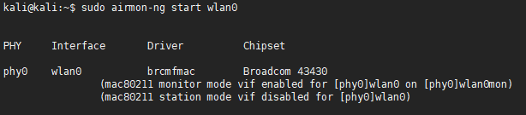
airmon-ng
sudo airmon-ng start wlan0
Creating wlan0mon monitor interface over wlan0.

Slide 25
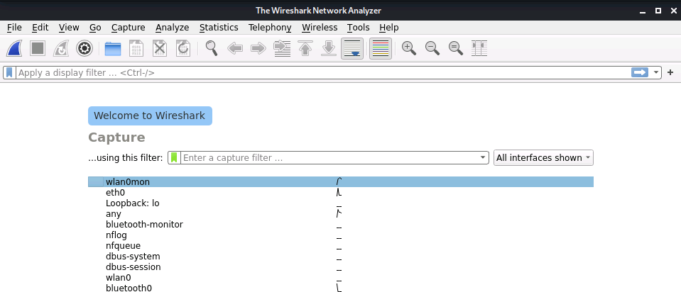
airmon-ng
Wireshark does detect wlan0mon interface.

Slide 26
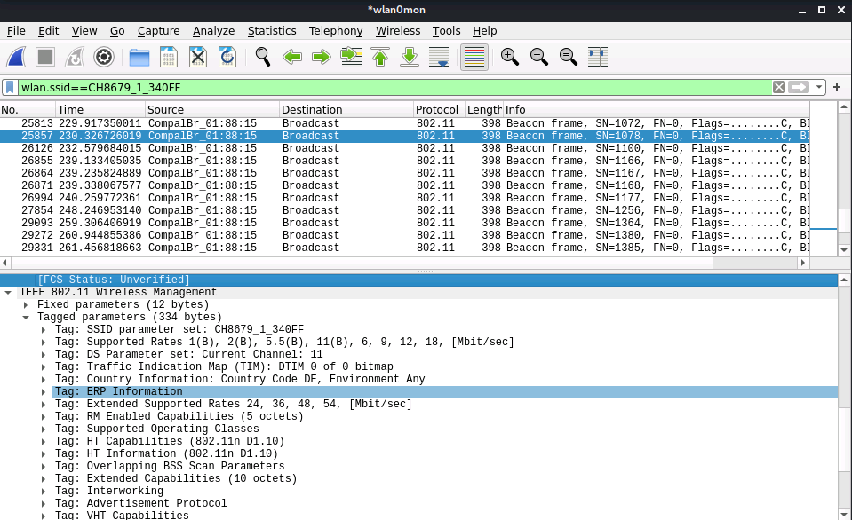
airmon-ng

Slide 27
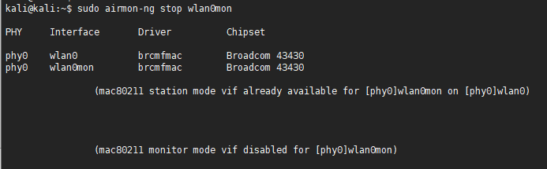
airmon-ng
sudo airmon-ng stop wlan0mon
Restore wlan0 interface into managed mode.

Slide 28
Conclusion to Approach 1
Feel very unreliable with airmon-ng tool.
Easily to crash on Wireshark.

Slide 29
Approach 2 - iw
yintao_ling

Slide 30
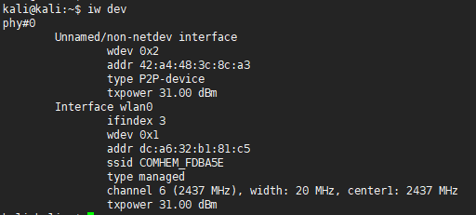
Getting started with iw
Checking monitor support on phy#0

Slide 31
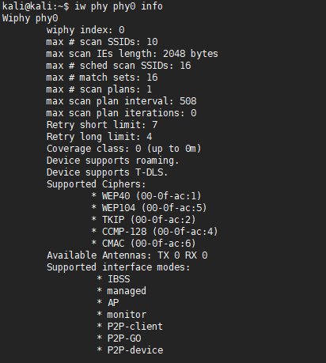
Checking phy0 info

Slide 32
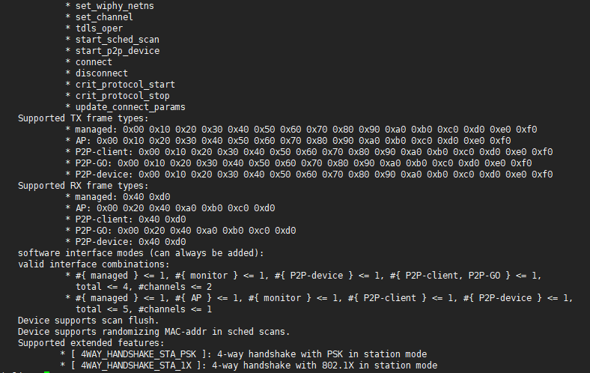
Checking phy0 info

Slide 33
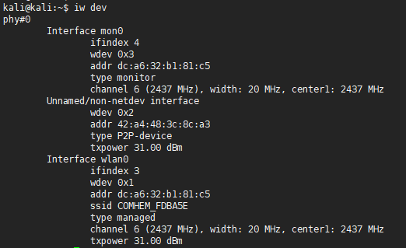
Capturing in Monitor Mode
sudo iw phy phy0 interface add mon0 type monitor

Slide 34
Capturing in Monitor Mode
sudo ifconfig wlan0 down
sudo iw dev mon0 set freq 2437 (Channel 6)
sudo ifconfig mon0 up

Slide 35
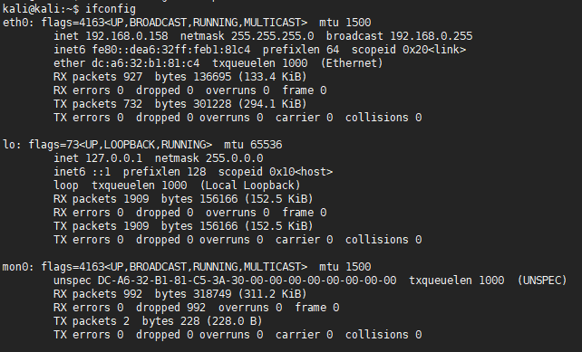
Checking phy0 info

Slide 36
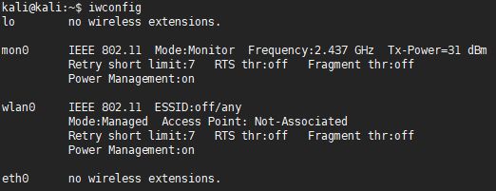
Checking phy0 info

Slide 37
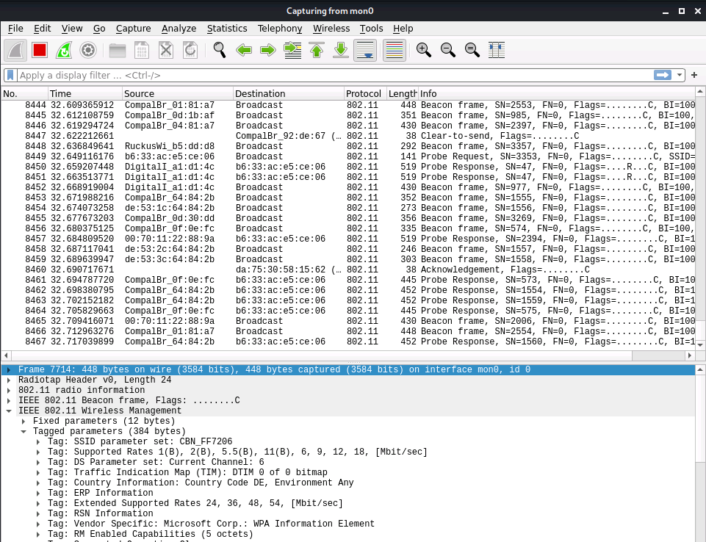
Capturing 802.11 Packets

Slide 38
Restoring to Managed Mode
sudo ifconfig wlan0 up
sudo ifconfig mon0 down

Slide 39
Conclusion to Approach 2
I think this is the better method rather than Approach 1.
The additional interface is much easier to manage.
However, the memory storage for packets is really large.
Need to re-setup once rebooting. -> Create script file ?

Slide 40
MacBook Air

Slide 41
Wireshark Filter for 802.11

Slide 42
Reference
https://askubuntu.com/questions/120973/how-do-i-start-vnc-server-on-boot
https://askubuntu.com/questions/41273/how-to-copy-paste-text-from-remote-system
https://www.raspberrypi.org/forums/viewtopic.php?t=216725
https://sandilands.info/sgordon/capturing-wifi-in-monitor-mode-with-iw
sudo update-rc.d vncserver defaults
sudo systemctl enable vncserver

Slide 43
Thank you for listening
yintao_ling

